Slide 1
blinky
Adam Barney
Quicken Loans
Senior Software Engineer
adambarney@quickenloans.com
adam@adambarney.com
beyond
making a “REAL” IoT thing
Notes:
up with

Slide 2

Quicken Loans
TECHNOLOGY

Slide 3
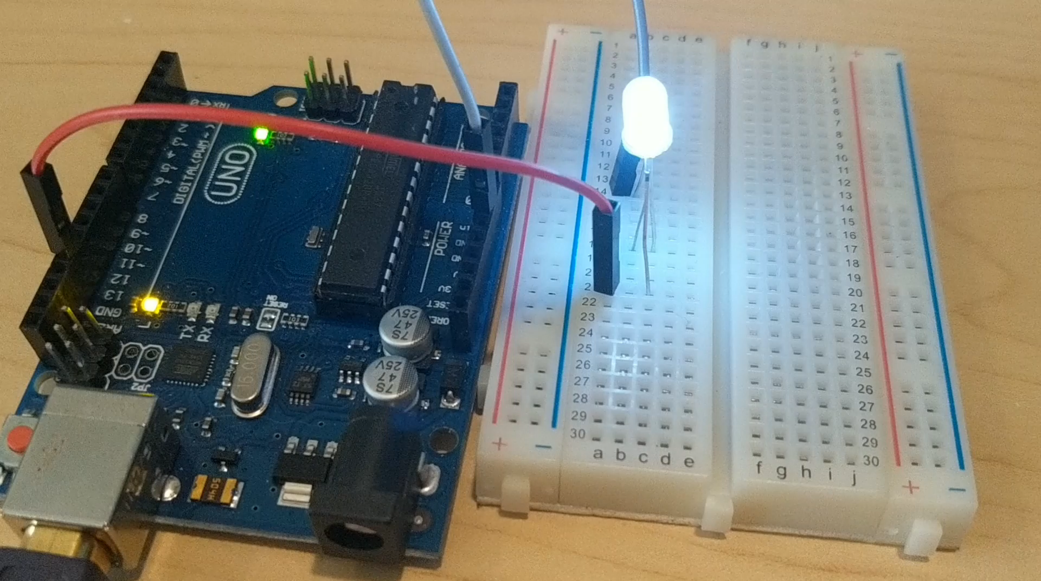
Notes:
This is the “Hello World!” of the Maker world – pretty much the first thing you do when getting started.

Slide 4
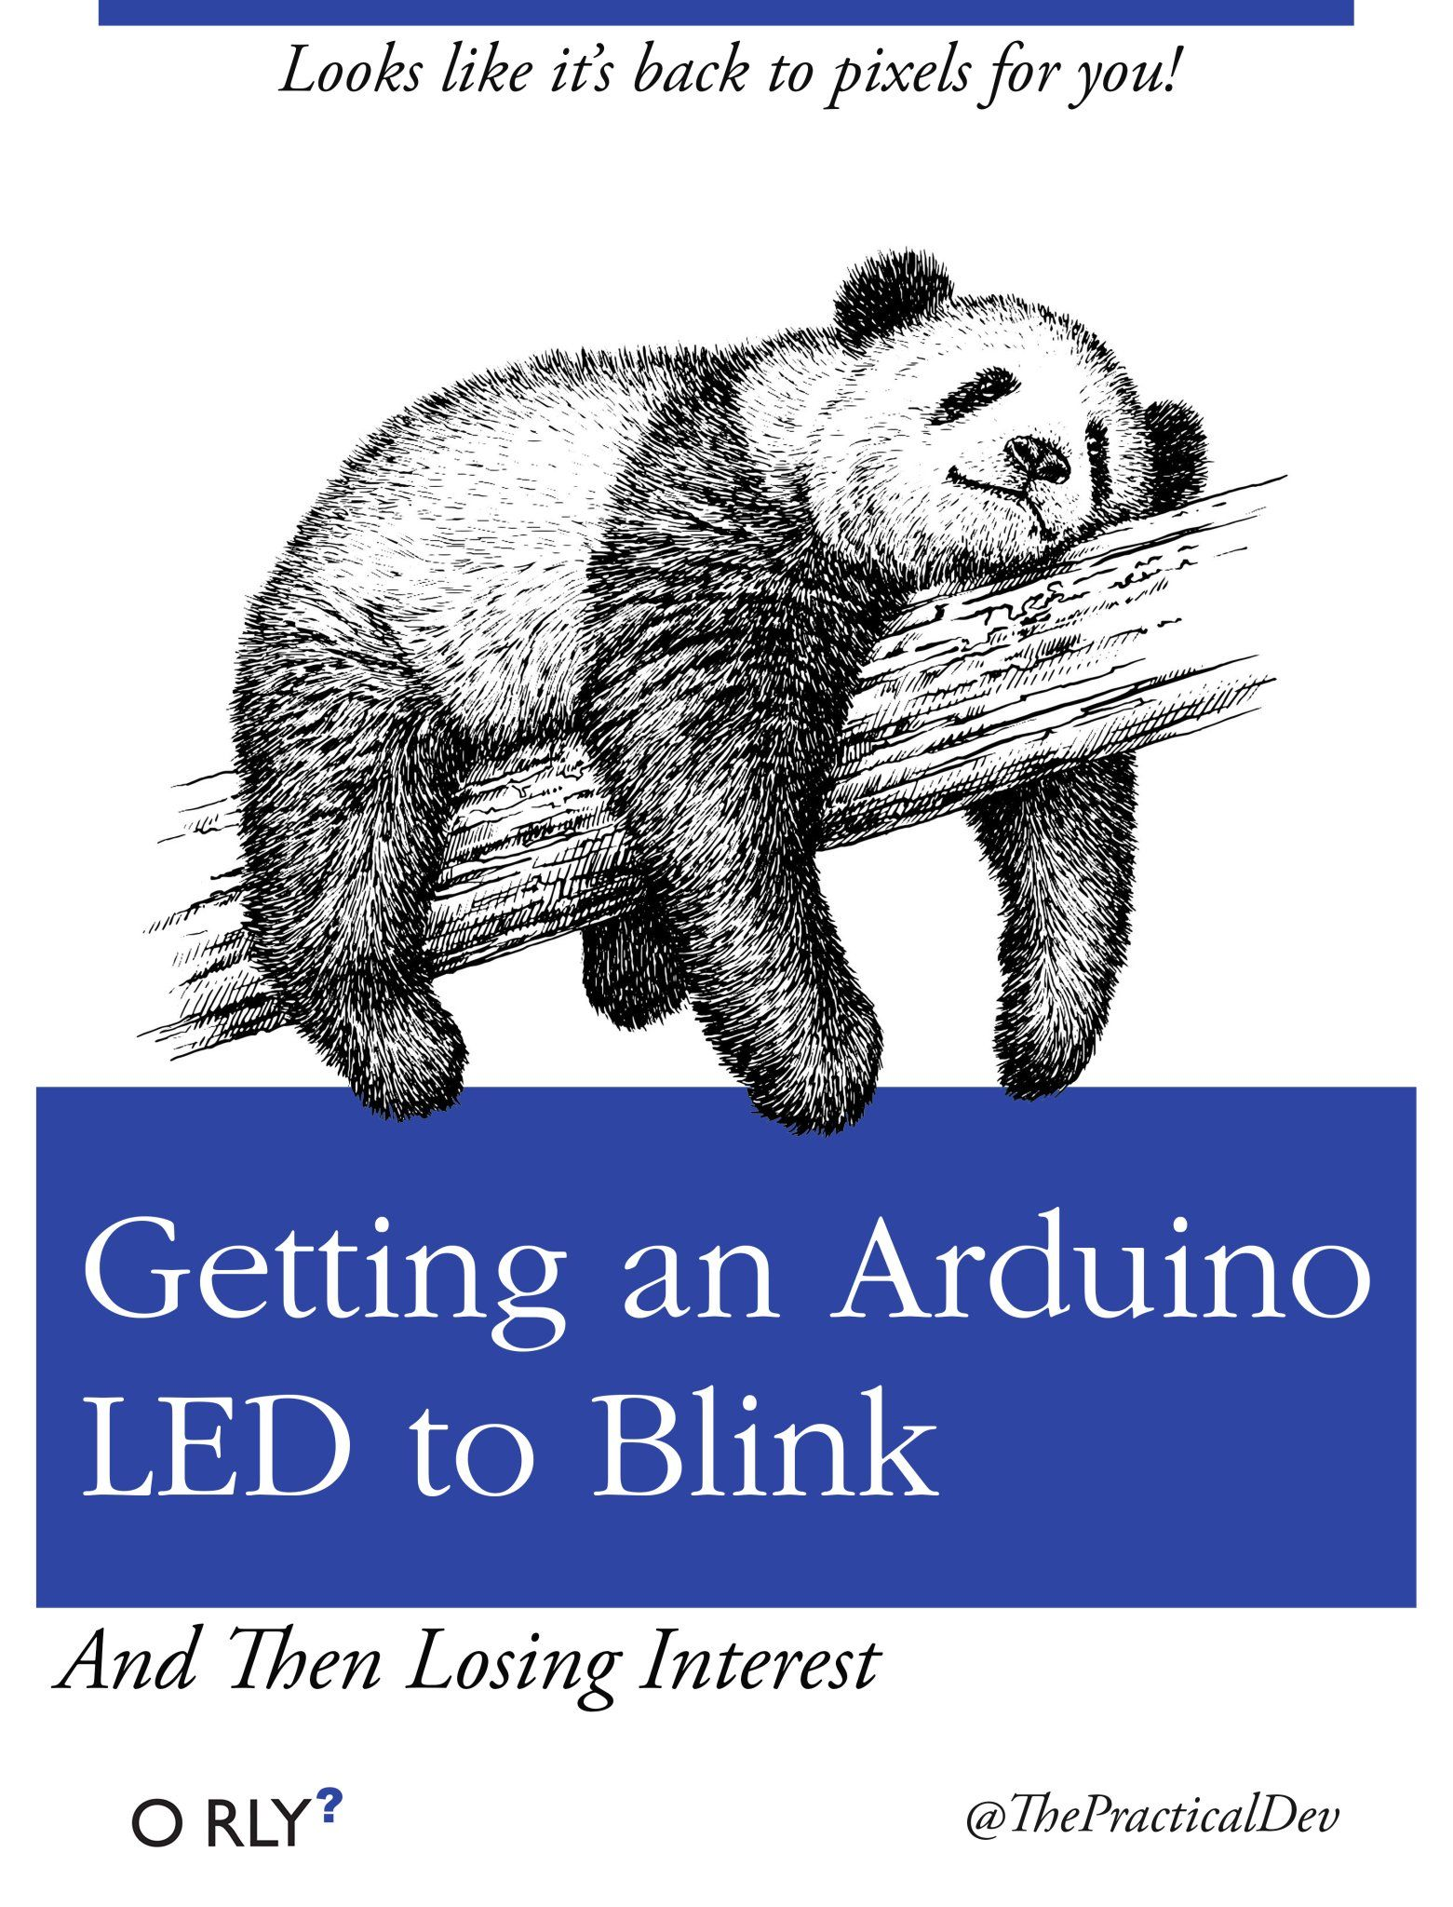
now
what?
Notes:
But now what? You have an extraordinary amount of computing power in your hand with limitless possibilities, so what can you do?
I’ll ask the audience for ideas that they’ve had, or projects they’ve made

Slide 5
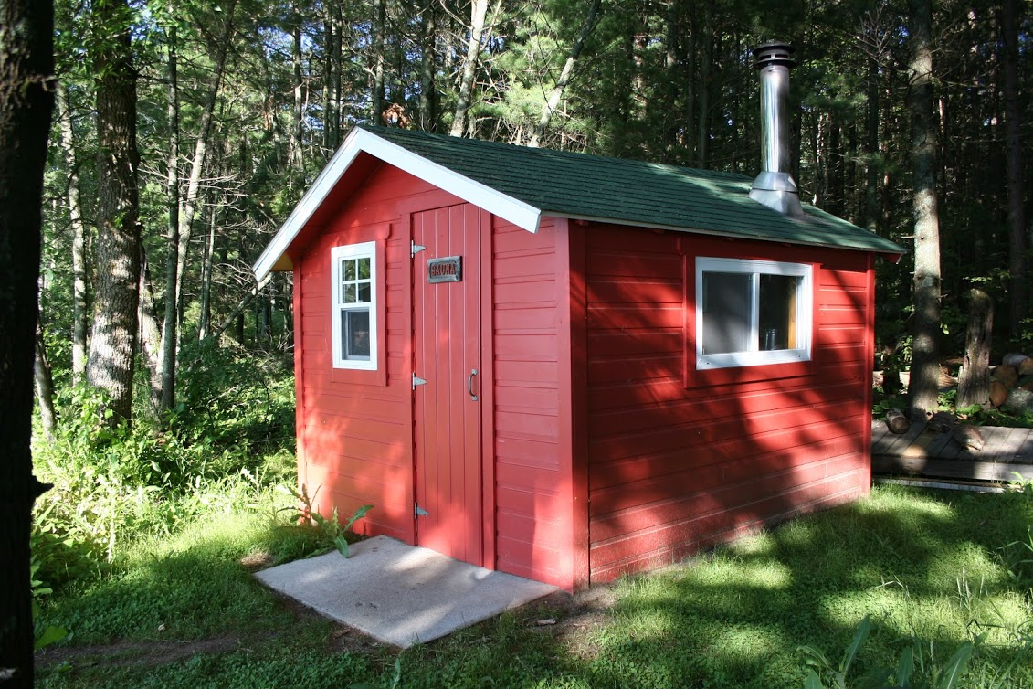
Notes:
So what did I decide to make? Well, this is our sauna that we have at our family vacation spot in northern MN. The basic idea of a sauna is that you get very hot and sweaty – to the point where virtually every pore is open and sweating profusely, then you run out and jump in a relatively cool lake, which slams all those cleared out pores shut almost instantly. They are called “Finnish Baths” as well, and the true Finns will cool themselves off by doing pullups through a hole in the ice!

Slide 6
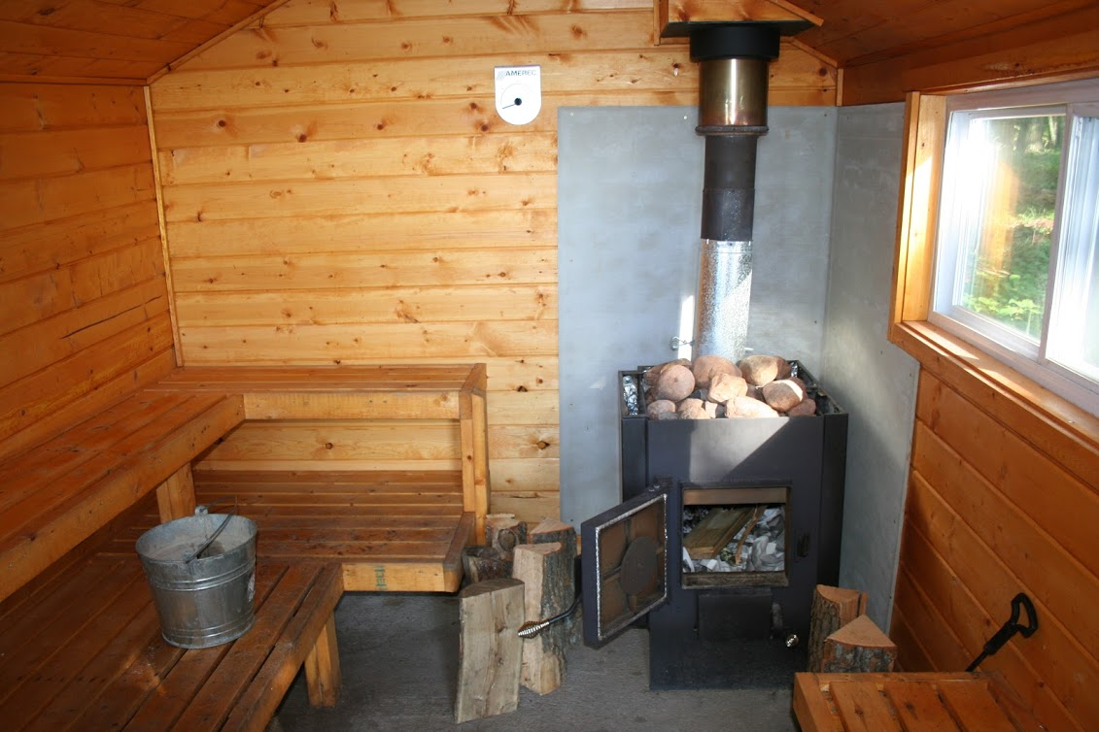
Notes:
Inside is a wood burning stove with rocks on top of it. We heat the room up to about 150-185 degrees Fahrenheit, then throw water on the rocks to fill the room with steam.
It takes an hour or two to get it up to temperature when starting it cold. Most of that time is spent waiting. Or walking down to check the temperature.

Slide 7
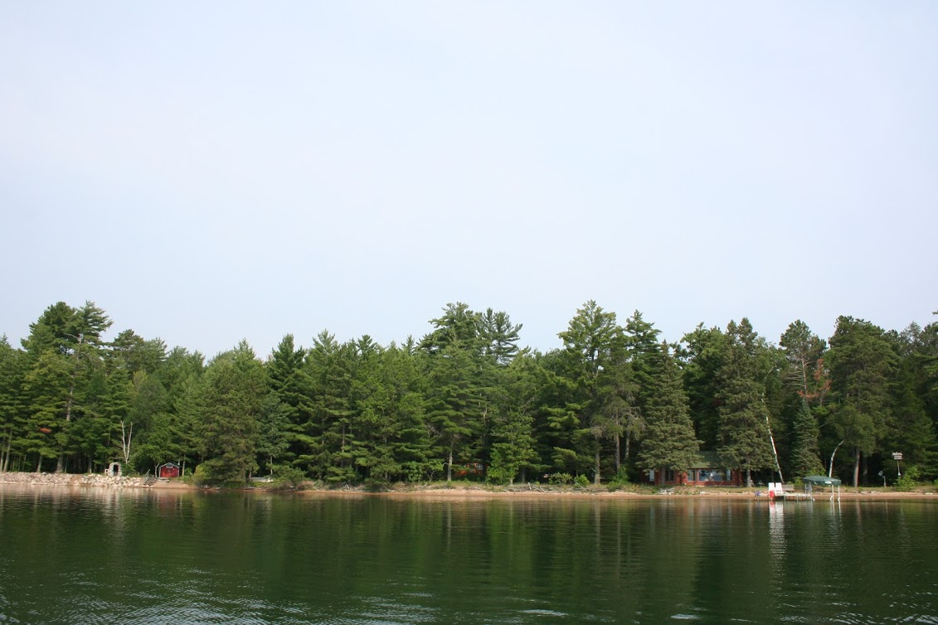
Notes:
It’s not a LONG walk, but it’s not super short, either. There’s our cabin on the right, and the sauna on the left.
What I wanted to do is create a way to check on the current conditions of the sauna without having to walk down there myself to check on the temperature.
And anything worth doing is worth overdoing, right? Others on our beach use it, so I also wanted to know whether our neighbors were currently using it at the time or not.
And I love science. And data. So I wanted to log temperature, humidity and whether there were people in it, when the door opens and closes so I can get an idea about what pouring water on the rocks really does to the temperature and humidity. We always berate people for opening the door, but what effect does opening the door really have on the interior conditions? I aimed to find out.

Slide 8
the
problem?

Slide 9
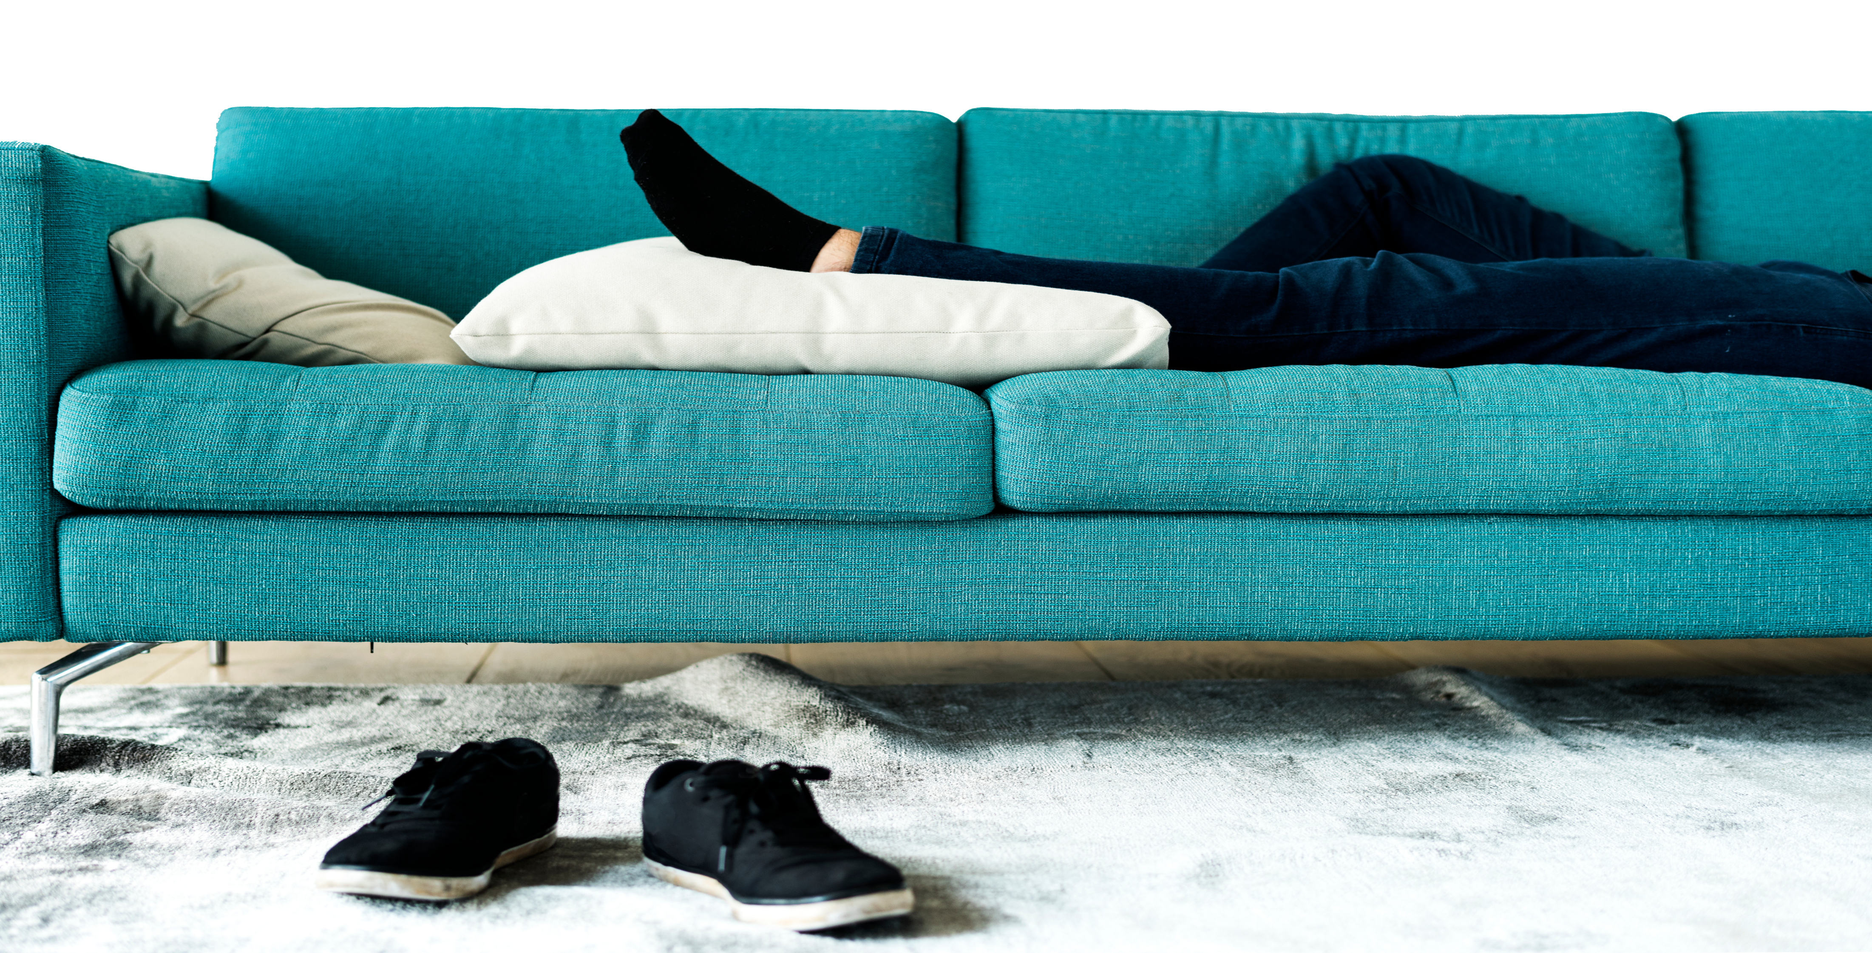
i’m lazy

Slide 10
the
solution?

Slide 11








technology!
Notes:
Build a device that will relay conditions in the sauna to the cabin
Temperature
Humidity
Motion (is it occupied)
Is the door open?
Send data to the cloud
Analyze (machine learning?) and report via web

Slide 12

Notes:
Build a device that will relay conditions in the sauna to the cabin
Temperature
Humidity
Motion (is it occupied)
Is the door open?
Send data to the cloud
Analyze (machine learning?) and report via web

Slide 13
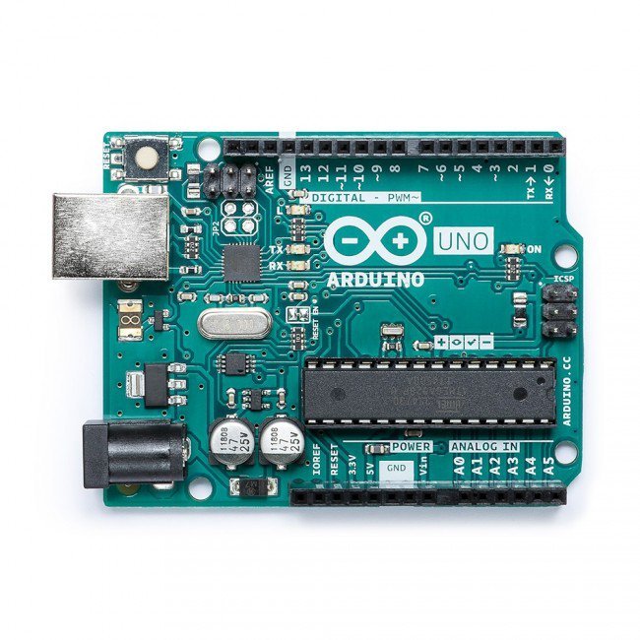
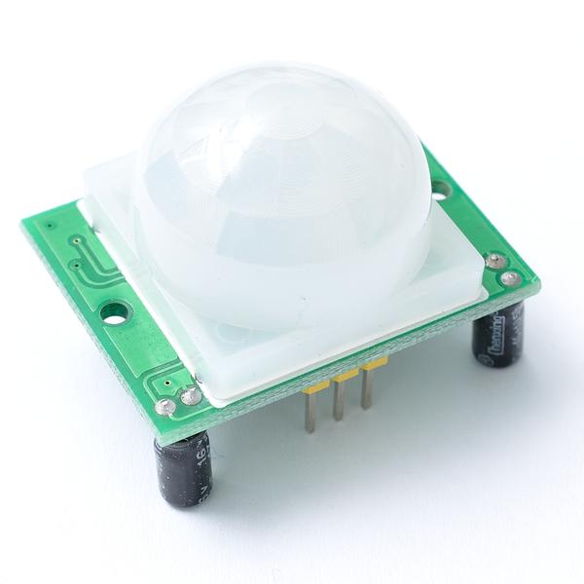
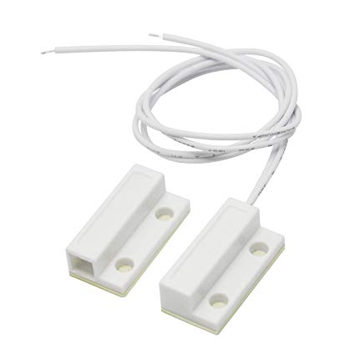
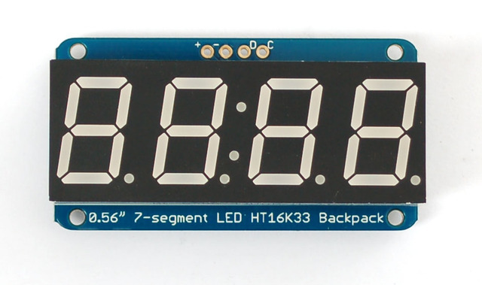
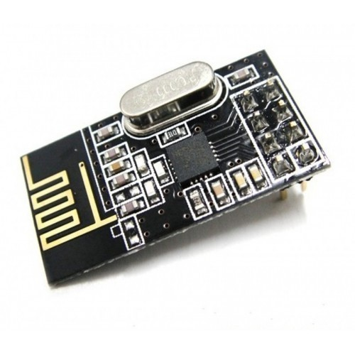
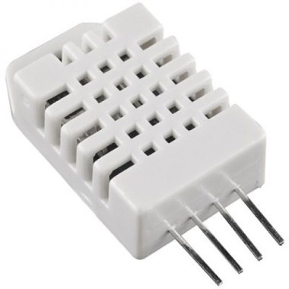
the basic
solution
Notes:
I found parts that would do what I needed. A temperature and humidity sensor, a motion sensor, a door sensor, and an LED readout for the temperature. All of these were connected to an Arduino uno to begin with.

Slide 14
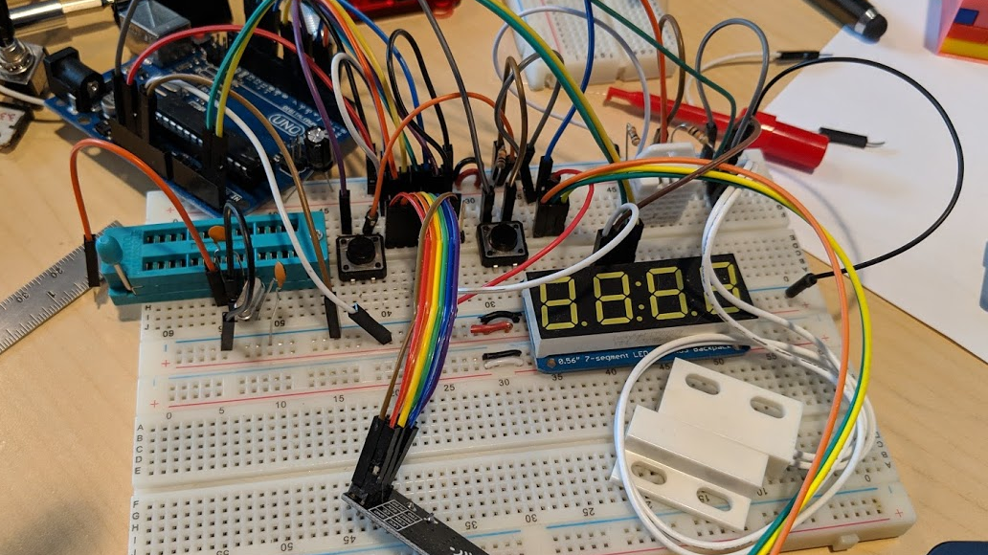
sauna monitor prototype
Notes:
This was the first prototype of the Sauna Monitor

Slide 15
challenges
Notes:
No power or internet at the sauna
The sauna is over 200 feet away (With a forest in between)
The sauna gets HOT - up to 100 degrees Celsius
Heat and humidity varies around the room
The sauna's charming, and should stay that way
This is not my full-time job

Slide 16
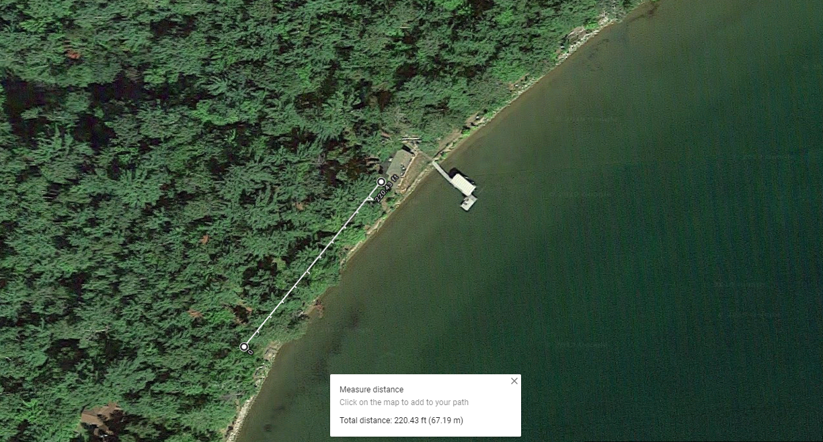
challenge #1:
distance
Notes:
The first problem to tackle was how do I display information from the sensors in the sauna somewhere in the cabin, which is a minimum of 200 feet away?
It’s too far to run jumper wires all that way (the signal would degrade over those distances)
I thought about trying to get the sauna pieces connected to the internet, but it’s far too far away from any wifi sources

Slide 17
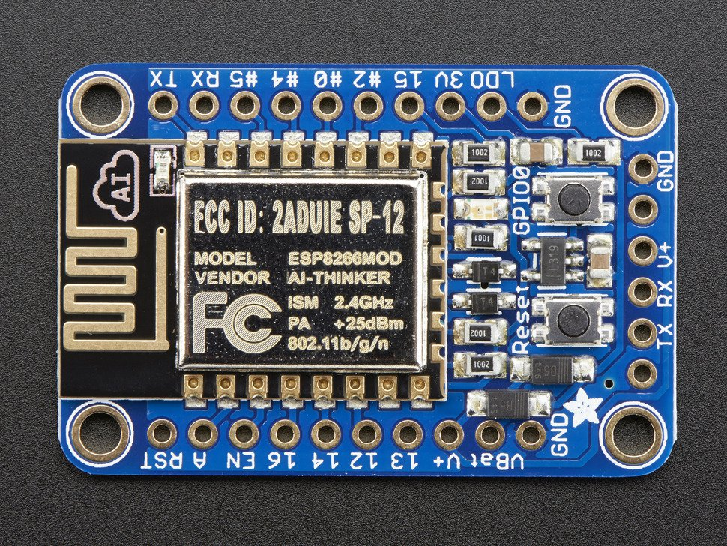
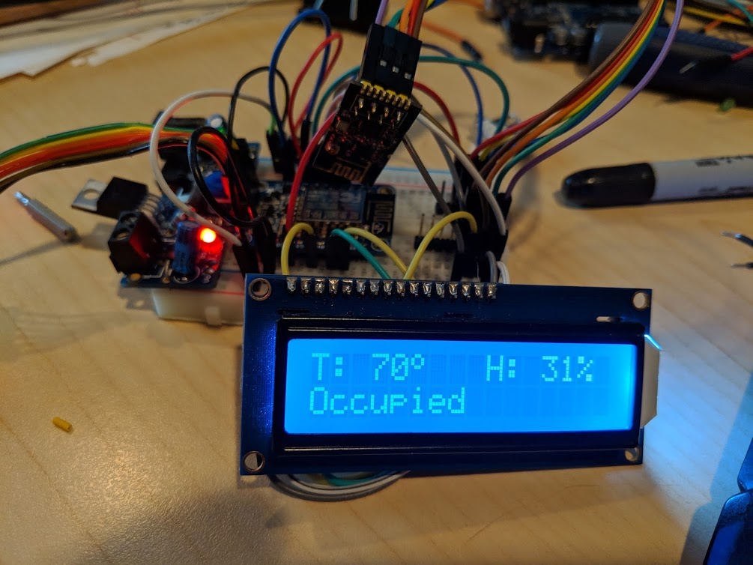
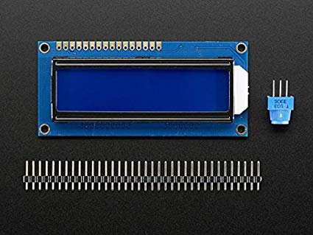
“server” unit – v1
Notes:
So the solution was to split it in to two parts – a Client unit, which would be in the sauna, and a Server unit which would stay in the cabin.
The Server unit was created with an Adafruit Huzzah breakout, which has built-in wifi, an LCD display, and an nRF2401L radio receiver to communicate wirelessly with the sauna unit.

Slide 18
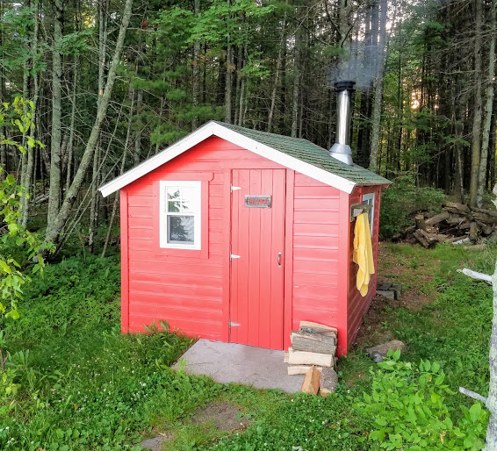
challenge #2:
power
Notes:
Now that we can communicate between the sauna and the cabin, we can turn our attention to power.
There is no power anywhere near the sauna, so it will need to be battery powered, but I do not want to constantly be changing the batteries.

Slide 19
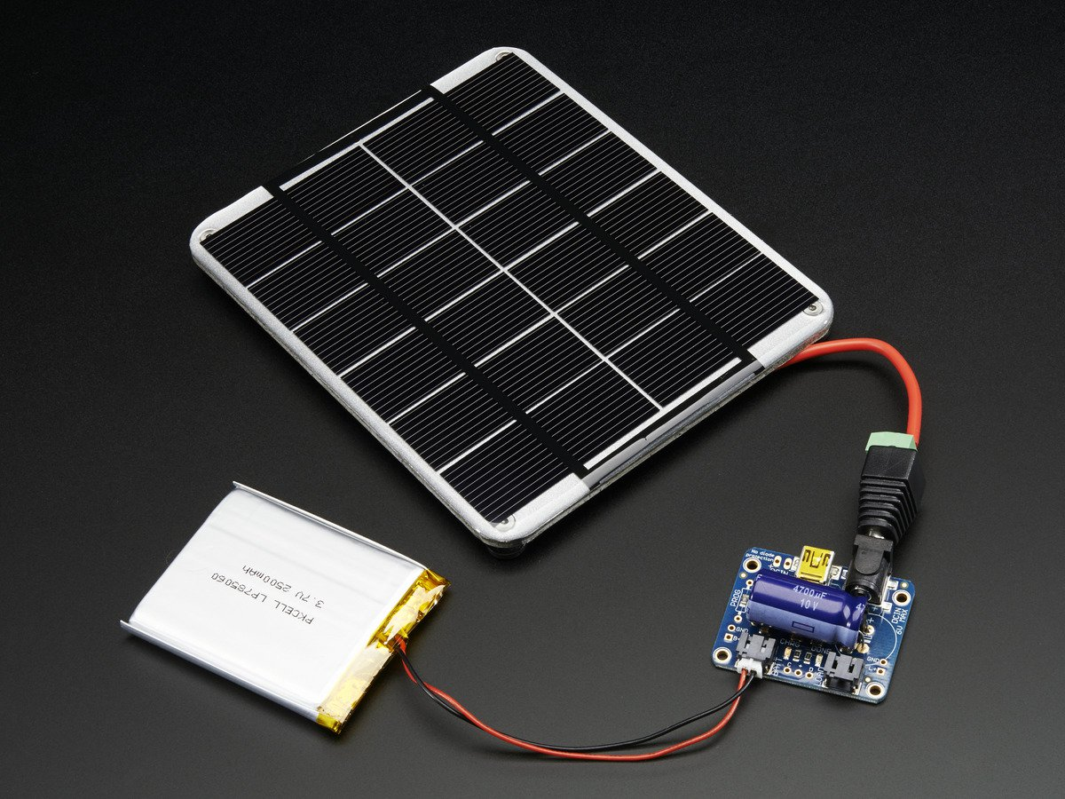
Notes:
My first approach was to use a LiPo battery and solar cell. My hope was to limit the power use of the client unit so that it could be powered by the solar cell, with the battery as a backup.
Unfortunately, in order to get the solar cell anywhere where it would generate usable current, I would need to run wires 20-30 feet away from the sauna. This is still an option later, but for v1, I didn’t want to add that as a complexity.
So I turned my attention to reducing the power consumption as much as possible

Slide 20
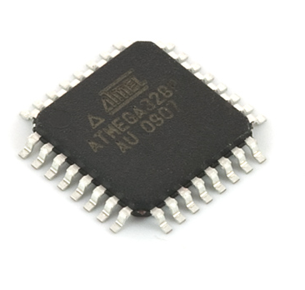
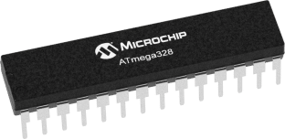
Arduino Uno ATMega328
Notes:
The Arduino Uno, along with other prototype boards are very convenient and easy to use when experimenting and developing a proof of concept. But the things that make them easy to use also makes them inefficient. They’re not designed to be used “in production” – they simply provide common extras you might need when first starting work with a microcontroller chip.
In this case, the microcontroller is the ATMega328. We can save a TON of power consumption by switching from the full Uno to just the chip. If we were to go with the SMD version of the chip, power consumption is even less.
And look at the prices as well – no consumer product would contain a $22 Arduino in a finished product.

Slide 21

optimizing power
http://www.gammon.com.au/power
Notes:
Run the processor at a lower frequency
Run the processor at a lower voltage
Turn off unneeded internal modules in software
Turn off brownout detection
Turn off the Analog-to-Digital converter (ADC)
Turn off the watchdog timer
Put the processor to sleep
Don't use inefficient voltage regulators
Don't use power-hungry displays
Wake the processor from sleep only when needed
Turn off external devices until needed

Slide 22
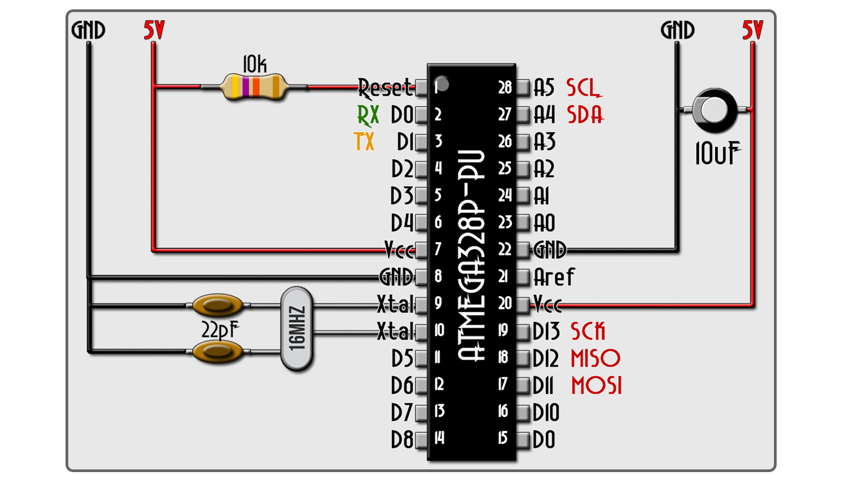
using the
ATMega328
by itself
Notes:
The AYMega328 can be used without the Arduino Uno in this way. If you examine the Uno itself, you’ll see the ocmponents in this schematic on the board, plus a bunch of things we don’t NEED.

Slide 23
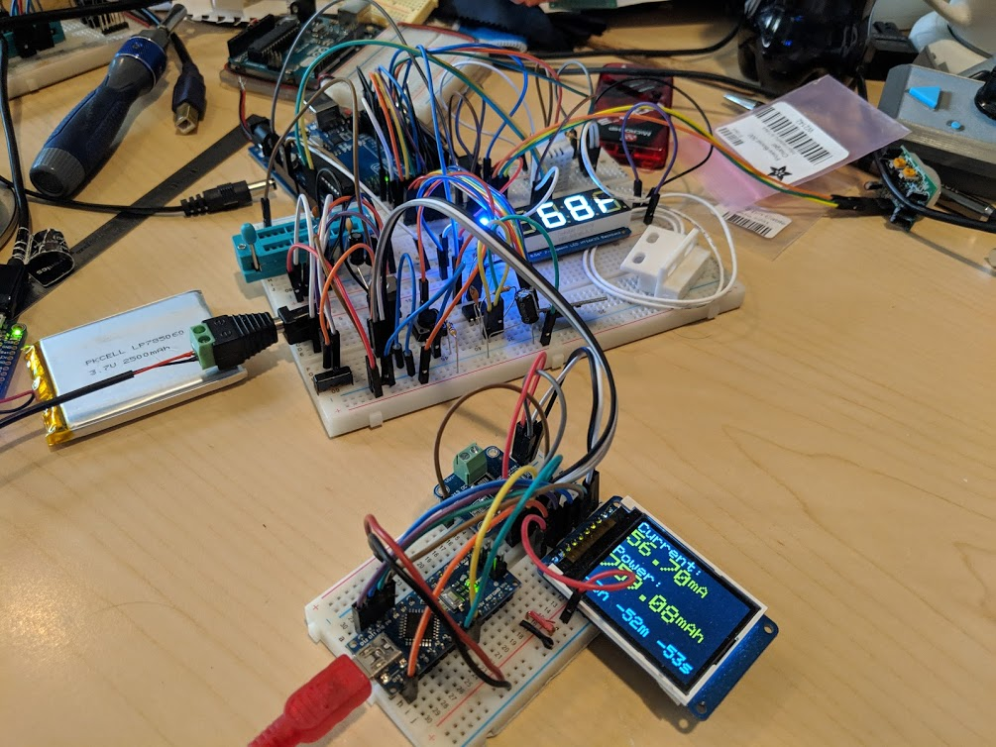
measuring power usage
Notes:
In order to see if I was making progress with power savings, I built this device to measure the current draw from my circuit.

Slide 24
run the processor at a lower frequency
optimizing power
Notes:
There’s a great site (link lower right) that details several things that can be done to reduce the ATMega’s power consumption from tens of milli-amps to as low as a couple micro-amps.
I used some of these, but not all. (briefly describe which were used, which weren’t and why)

Slide 25
run the processor at a lower frequency
run the processor at a lower voltage
optimizing power
Notes:
There’s a great site (link lower right) that details several things that can be done to reduce the ATMega’s power consumption from tens of milli-amps to as low as a couple micro-amps.
I used some of these, but not all. (briefly describe which were used, which weren’t and why)

Slide 26
run the processor at a lower frequency
run the processor at a lower voltage
turn off unneeded internal modules in software
optimizing power
Notes:
There’s a great site (link lower right) that details several things that can be done to reduce the ATMega’s power consumption from tens of milli-amps to as low as a couple micro-amps.
I used some of these, but not all. (briefly describe which were used, which weren’t and why)

Slide 27
run the processor at a lower frequency
run the processor at a lower voltage
turn off unneeded internal modules in software
turn off brownout detection
optimizing power
Notes:
There’s a great site (link lower right) that details several things that can be done to reduce the ATMega’s power consumption from tens of milli-amps to as low as a couple micro-amps.
I used some of these, but not all. (briefly describe which were used, which weren’t and why)

Slide 28
run the processor at a lower frequency
run the processor at a lower voltage
turn off unneeded internal modules in software
turn off brownout detection
turn off the Analog-to-Digital converter (ADC)
optimizing power
Notes:
There’s a great site (link lower right) that details several things that can be done to reduce the ATMega’s power consumption from tens of milli-amps to as low as a couple micro-amps.
I used some of these, but not all. (briefly describe which were used, which weren’t and why)

Slide 29
run the processor at a lower frequency
run the processor at a lower voltage
turn off unneeded internal modules in software
turn off brownout detection
turn off the Analog-to-Digital converter (ADC)
turn off the watchdog timer
optimizing power
Notes:
There’s a great site (link lower right) that details several things that can be done to reduce the ATMega’s power consumption from tens of milli-amps to as low as a couple micro-amps.
I used some of these, but not all. (briefly describe which were used, which weren’t and why)

Slide 30
run the processor at a lower frequency
run the processor at a lower voltage
turn off unneeded internal modules in software
turn off brownout detection
turn off the Analog-to-Digital converter (ADC)
turn off the watchdog timer
put the processor to sleep
optimizing power
Notes:
There’s a great site (link lower right) that details several things that can be done to reduce the ATMega’s power consumption from tens of milli-amps to as low as a couple micro-amps.
I used some of these, but not all. (briefly describe which were used, which weren’t and why)

Slide 31
run the processor at a lower frequency
run the processor at a lower voltage
turn off unneeded internal modules in software
turn off brownout detection
turn off the Analog-to-Digital converter (ADC)
turn off the watchdog timer
put the processor to sleep
don't use inefficient voltage regulators
optimizing power
Notes:
There’s a great site (link lower right) that details several things that can be done to reduce the ATMega’s power consumption from tens of milli-amps to as low as a couple micro-amps.
I used some of these, but not all. (briefly describe which were used, which weren’t and why)

Slide 32
run the processor at a lower frequency
run the processor at a lower voltage
turn off unneeded internal modules in software
turn off brownout detection
turn off the Analog-to-Digital converter (ADC)
turn off the watchdog timer
put the processor to sleep
don't use inefficient voltage regulators
don't use power-hungry displays
optimizing power
Notes:
There’s a great site (link lower right) that details several things that can be done to reduce the ATMega’s power consumption from tens of milli-amps to as low as a couple micro-amps.
I used some of these, but not all. (briefly describe which were used, which weren’t and why)

Slide 33
run the processor at a lower frequency
run the processor at a lower voltage
turn off unneeded internal modules in software
turn off brownout detection
turn off the Analog-to-Digital converter (ADC)
turn off the watchdog timer
put the processor to sleep
don't use inefficient voltage regulators
don't use power-hungry displays
wake the processor from sleep only when needed
optimizing power
Notes:
There’s a great site (link lower right) that details several things that can be done to reduce the ATMega’s power consumption from tens of milli-amps to as low as a couple micro-amps.
I used some of these, but not all. (briefly describe which were used, which weren’t and why)

Slide 34
run the processor at a lower frequency
run the processor at a lower voltage
turn off unneeded internal modules in software
turn off brownout detection
turn off the Analog-to-Digital converter (ADC)
turn off the watchdog timer
put the processor to sleep
don't use inefficient voltage regulators
don't use power-hungry displays
wake the processor from sleep only when needed
turn off external devices until needed
optimizing power
Notes:
There’s a great site (link lower right) that details several things that can be done to reduce the ATMega’s power consumption from tens of milli-amps to as low as a couple micro-amps.
I used some of these, but not all. (briefly describe which were used, which weren’t and why)

Slide 35
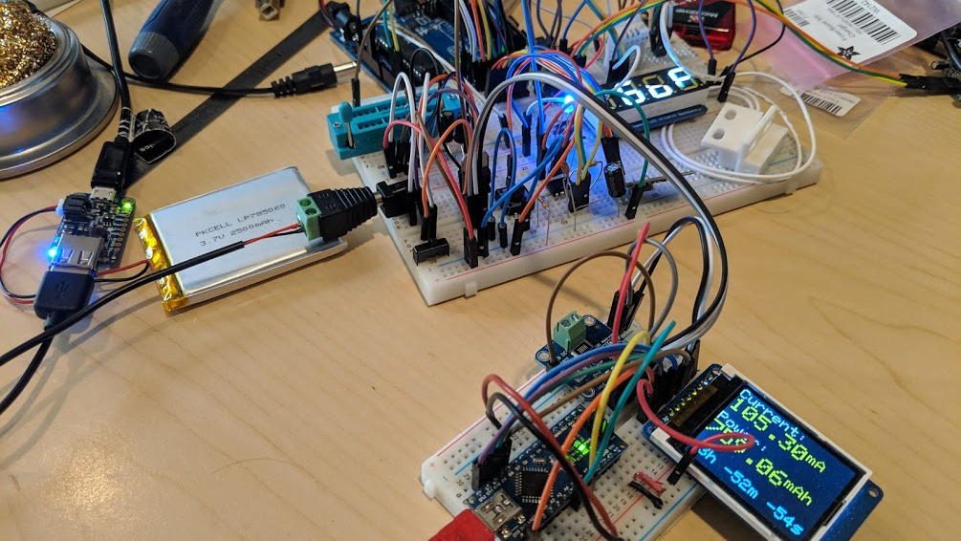
Arduino Uno
Notes:
This is the client module when it was running off of the Uno itself. Notice the current draw – 105 mA. On a 2500mAH batter, that gives us about a day of use

Slide 36
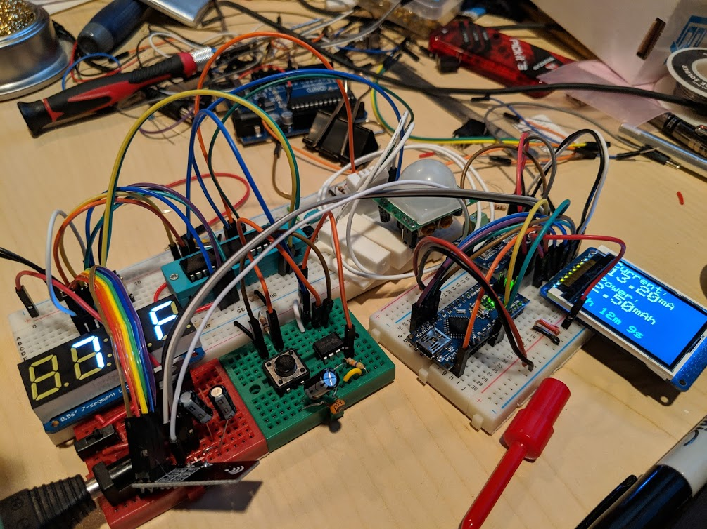
ATMega328
Notes:
Now notice that I have the ATMega chip on the breadboard, without the Uno. Power use here is 13mA, or about 8 days worth of usage. I eventually got it down to about 8-9 mA, or almost 2 weeks. My plan was to purchase a 20,000 mAH battery, which would give me 4 months – the whole summer!
For reference, the solar cell in full sunlight can generate up to 330mA – more than enough to power the unit and keep a battery fully charged for use at night and during overcast days.

Slide 37
challenge #3:
heat
Notes:
It was about this time that I started thinking about how the components might stand up to the unique environment – very hot and very humid. A good sauna is about 150-185 degrees F (65 – 85 degrees C), but they can get up to 210, or almost 100 C. How would things stand up? To find out, we need to check all of the components datasheets!

Slide 38
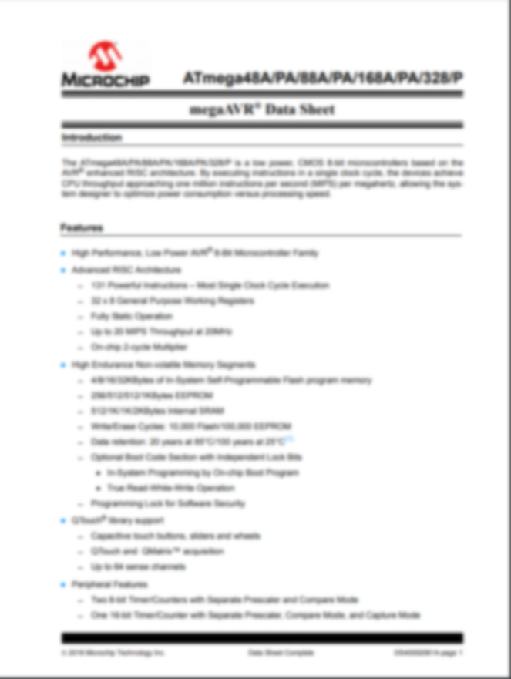
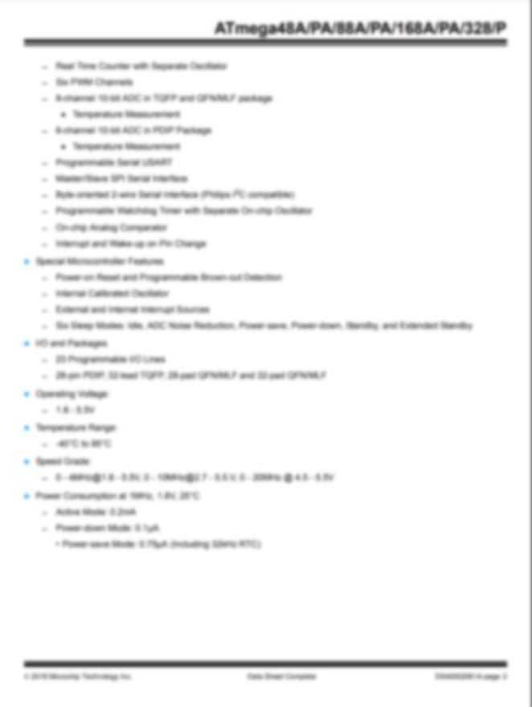
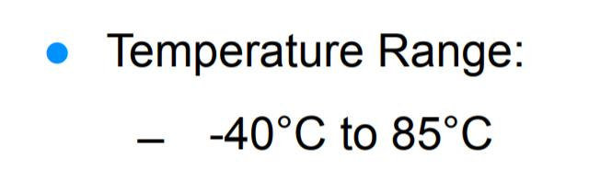
Notes:
This is the ATMega328 data sheet. That operating range is borderline for our sauna range. Chances are it would be ok, but we’d be pushing it.

Slide 39
check your data sheets!
Component | Maximum Operating Temperature
ATMega328 | 85°C
Battery | 60°C (with lower performance) and RISKY!
Ceramic Capacitors | 85°C
Oscillator | 70°C
nRF24L01 | 85°C
LED Display | 85°C
PIR Motion Display | 50-60°C
DHT22 | 125°C
Notes:
Other components have issues too. The Oscillator will start fluctuating if the temperature changes too much, and it has a narrower range. Some of our less critical sensors are on the edge too, but slightly skewed readings wouldn’t be awful. The LiPo battery is the biggest concern. Even at 60 C, the life and output of the battery is significantly effected, and those things have a history of doing bad things (like exploding or catching fire) when they are stressed.
The important parts of the client unit can’t be in the sauna itself. So, what to do?

Slide 40
client base unit
sensor unit
Notes:
CLIENT: Microcontroller, Battery, power management, 555, nRF24L01, other circuitry
SENSOR: DTH22, PIR, Button, Door

Slide 41
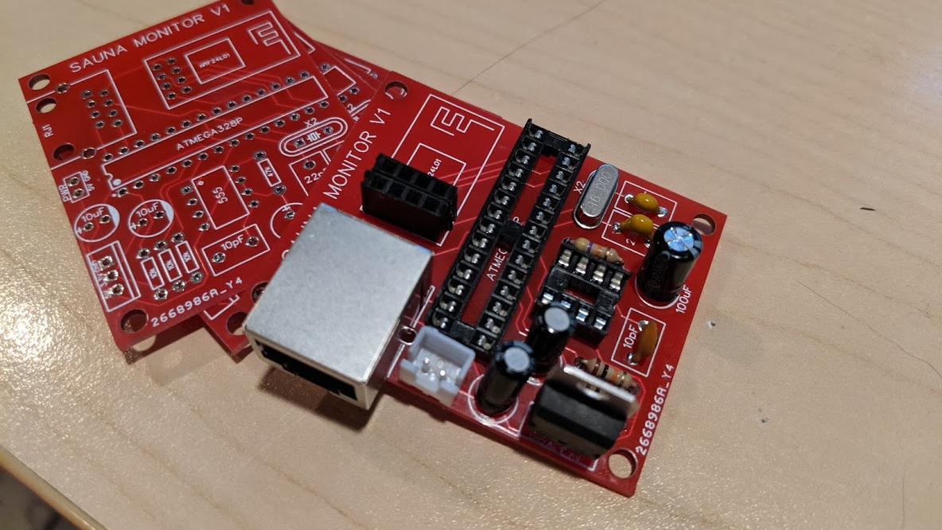
making it real:
PCB design
Notes:
A breadboard with wires and components hanging all over the place is not something you’d ever go to market with. To make a “real” product, you need to make Printed Circuit Boards (PCBs)

Slide 42
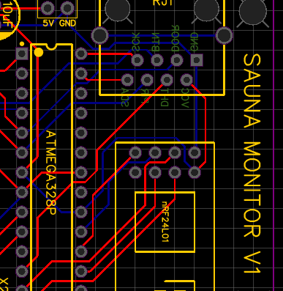
PCB Layers
(2-layer PCB)
top silkscreen
top solder mask
top copper
PCB board
bottom copper
bottom solder mask
bottom silkscreen

Slide 43


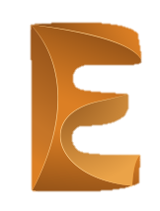


PCB designer choices
+ many, many, more

Slide 44

demo:
easyEDA

Slide 45
make your own
have it manufactured

Slide 46
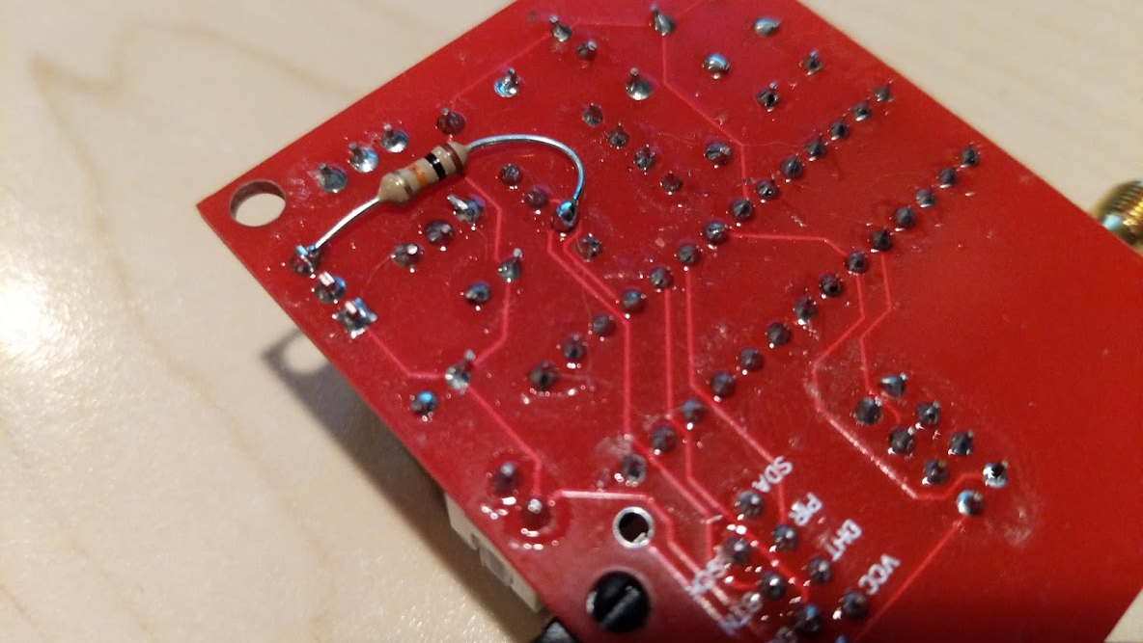
PCB design: lessons learned

Slide 47

check your schematic
lessons learned

Slide 48
check your schematic
check you schematic again
lessons learned

Slide 49
check your schematic
check you schematic again
check your part numbers
lessons learned

Slide 50
check your schematic
check you schematic again
check your part numbers
check those again too
lessons learned

Slide 51
check your schematic
check you schematic again
check your part numbers
check those again too
through-hole components are easier, but SMD is how things are done
lessons learned

Slide 52
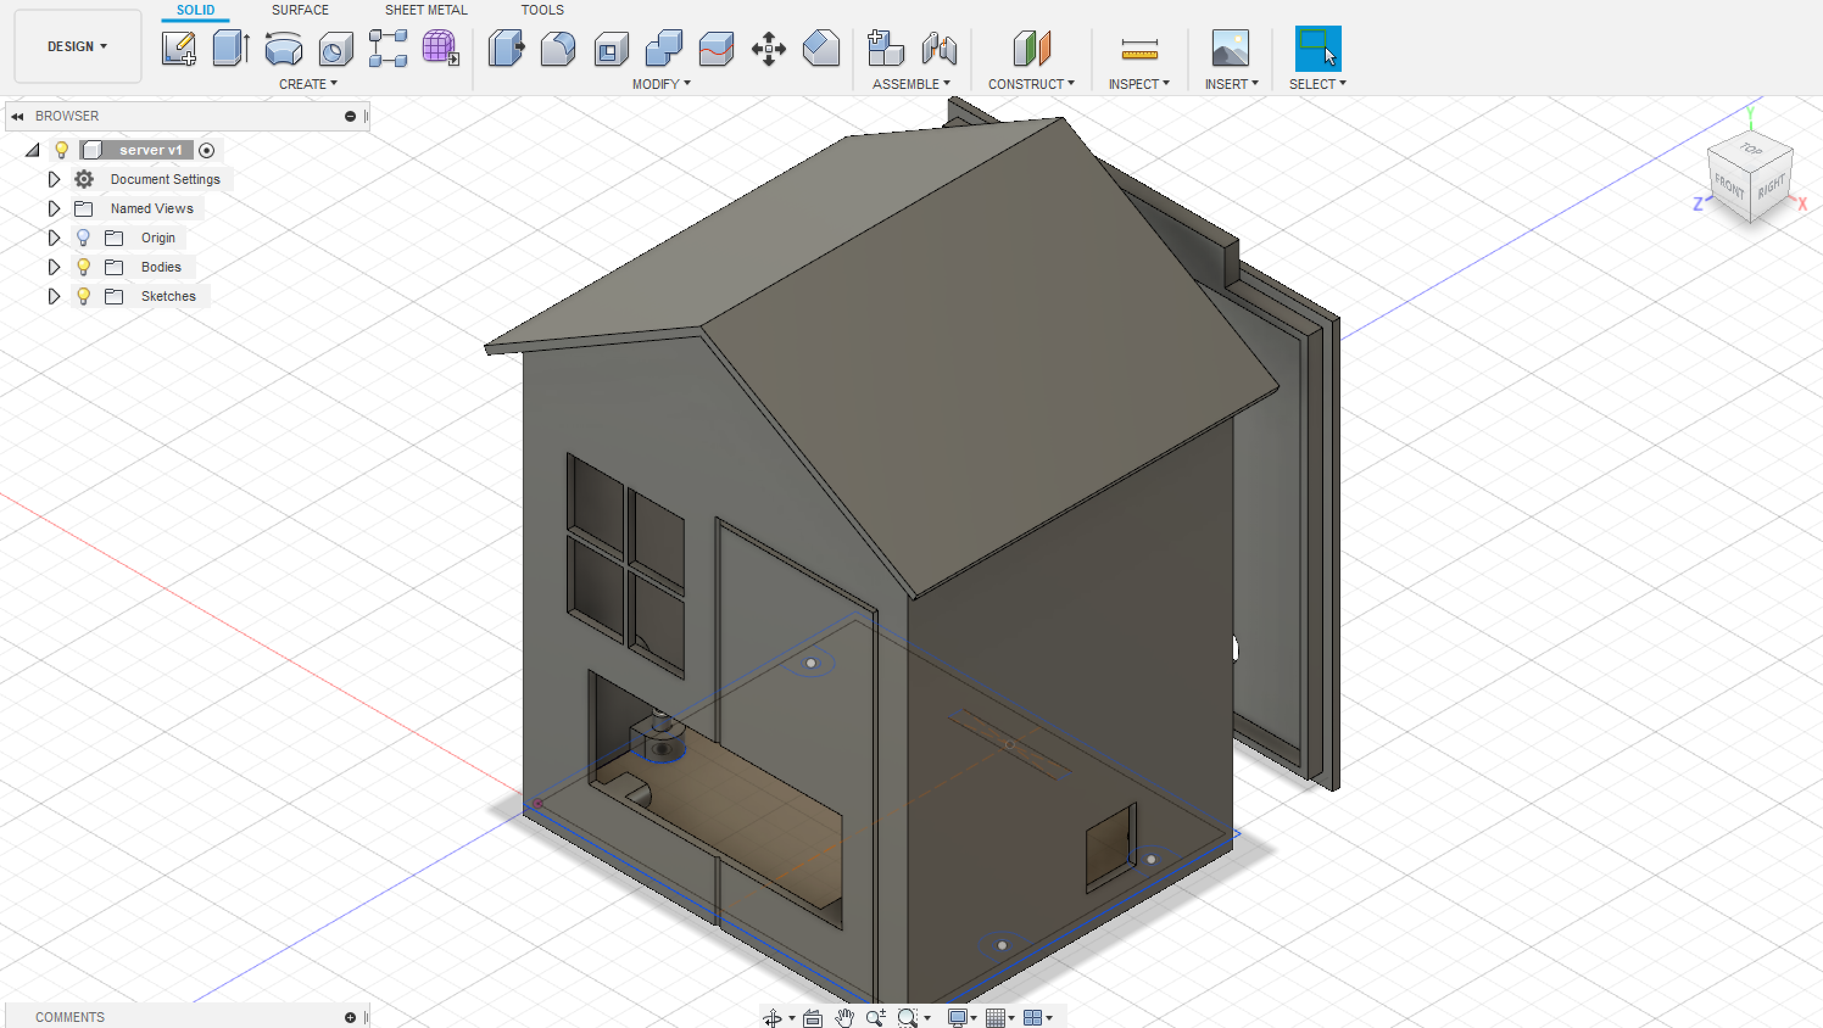
making it real: enclosures

Slide 53



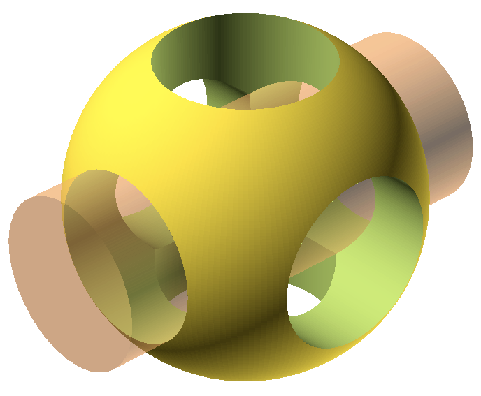

3-D design software

Slide 54
demo:
fusion 360

Slide 55
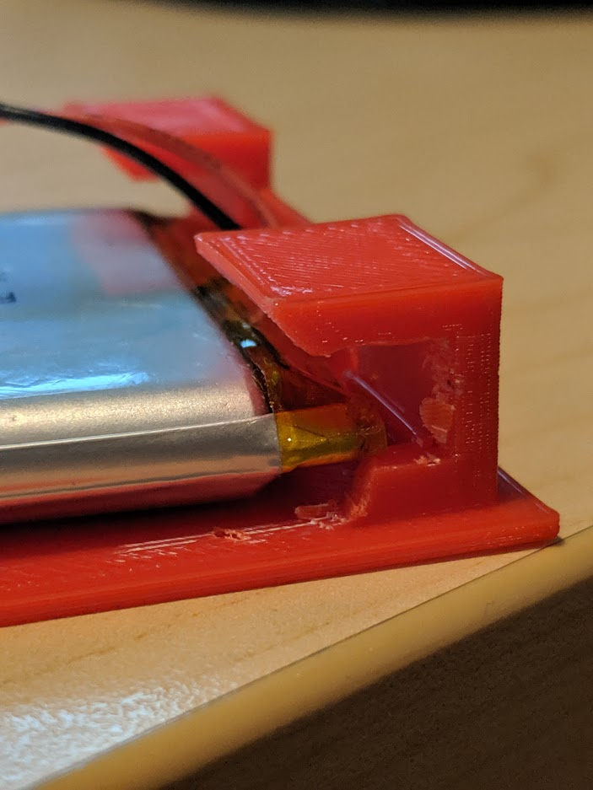
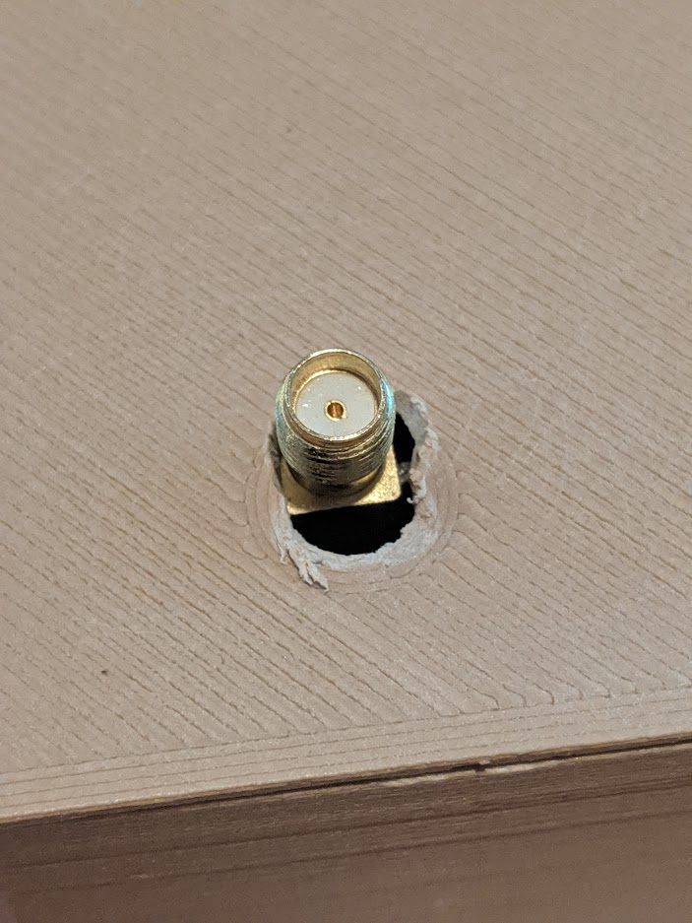
enclosures: lessons learned

Slide 56
measure twice, model once
lessons learned

Slide 57
measure twice, model once
plan a couple iterations of design & printing
lessons learned

Slide 58
measure twice, model once
plan a couple iterations of design & printing
0.25-0.5 mm tolerances for press-fit interfaces
lessons learned

Slide 59
measure twice, model once
plan a couple iterations of design & printing
0.25-0.5 mm tolerances for press-fit interfaces
fusion 360 is a powerful tool
lessons learned

Slide 60
measure twice, model once
plan a couple iterations of design & printing
0.25-0.5 mm tolerances for press-fit interfaces
fusion 360 is a powerful tool
make sure printing material works for your environment
lessons learned

Slide 61
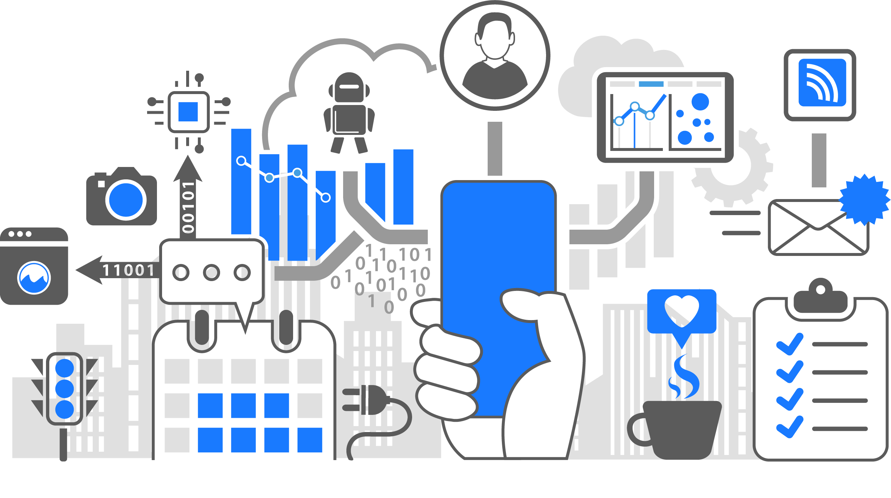
let’s talk about IoT
Notes:
Azure IoT Hub+ Event Grid + Azure Functions + Table Storage = EXPENSIVE
These tools are made for large scale solutions
Ended up just writing to Table Storage alone

Slide 62

putting it
all together

Slide 63
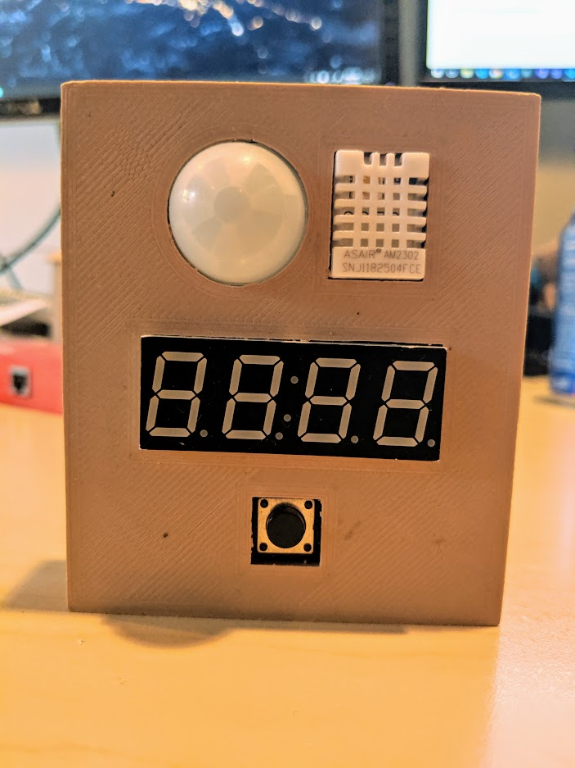
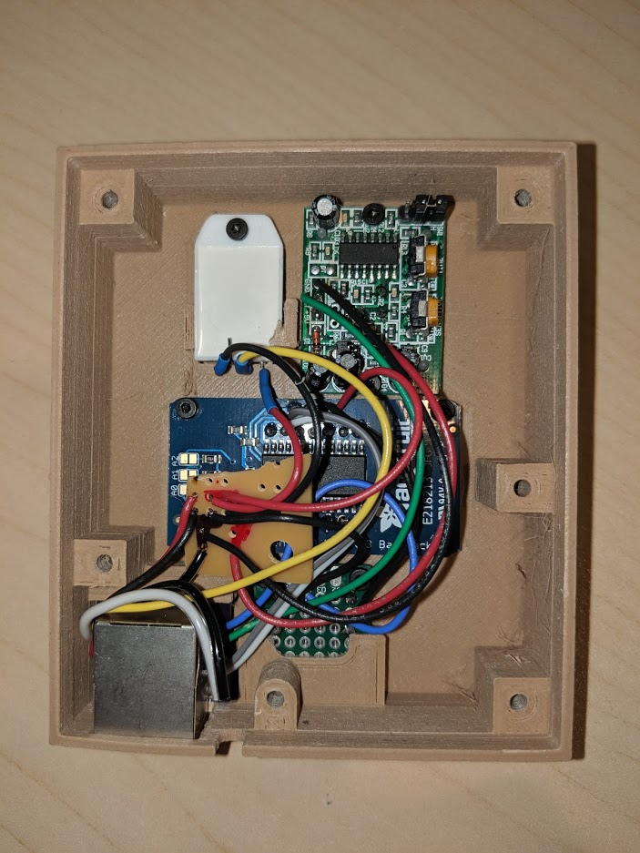
sensor unit

Slide 64
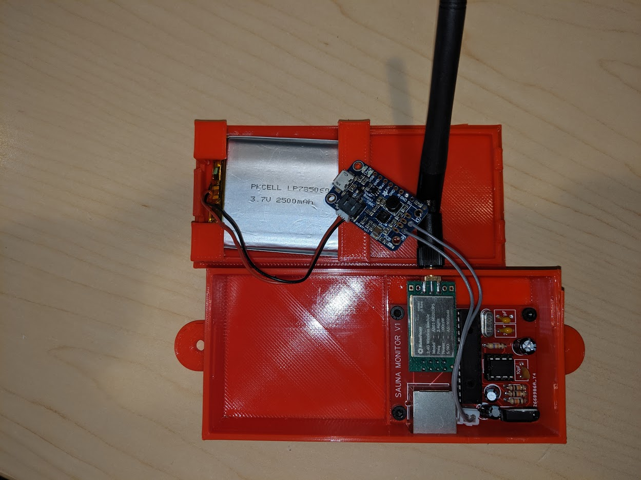
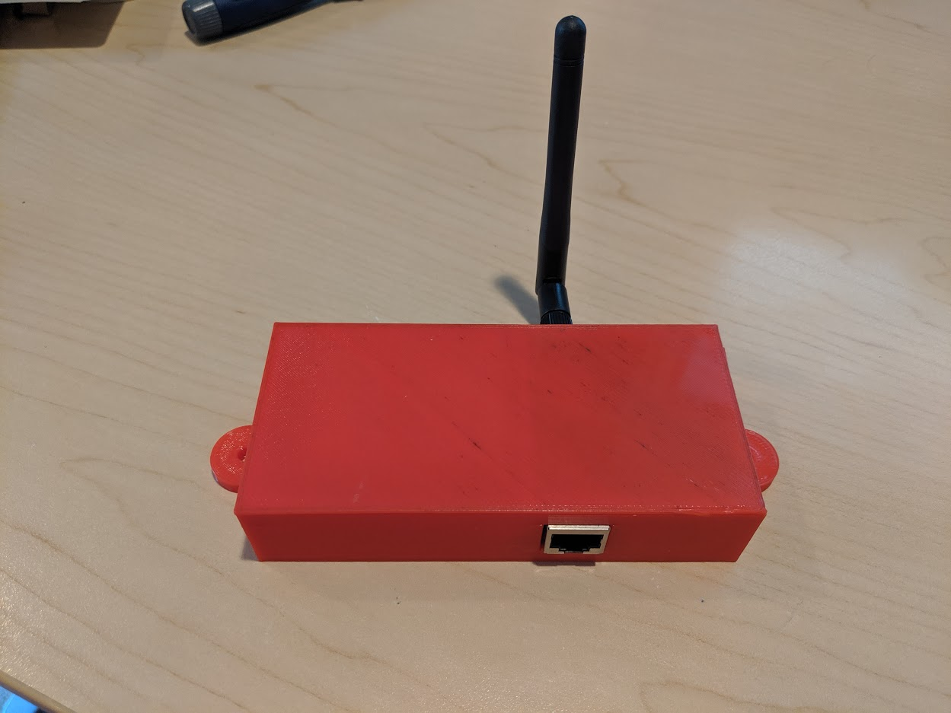
client base unit

Slide 65
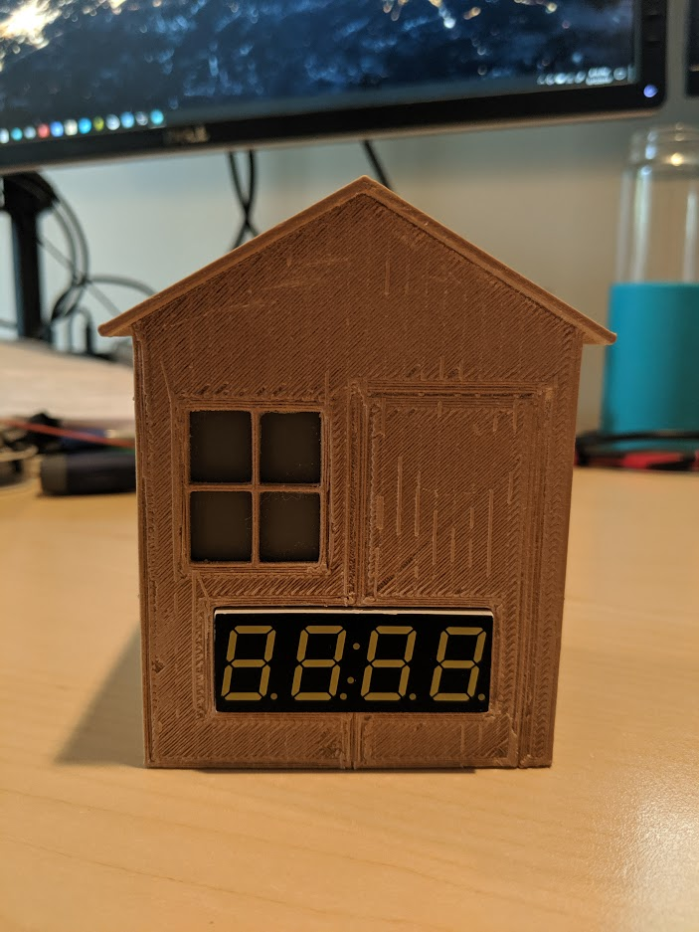
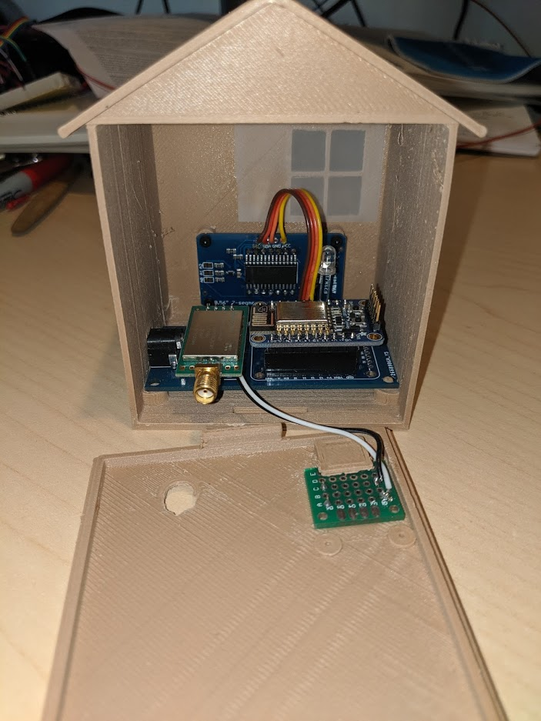
server unit

Slide 66
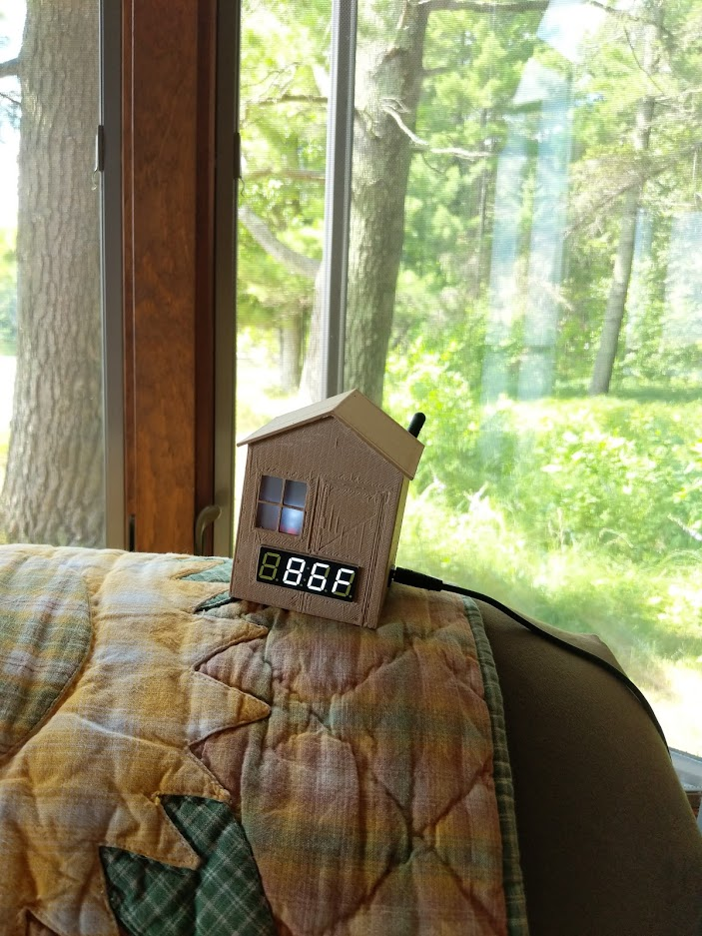
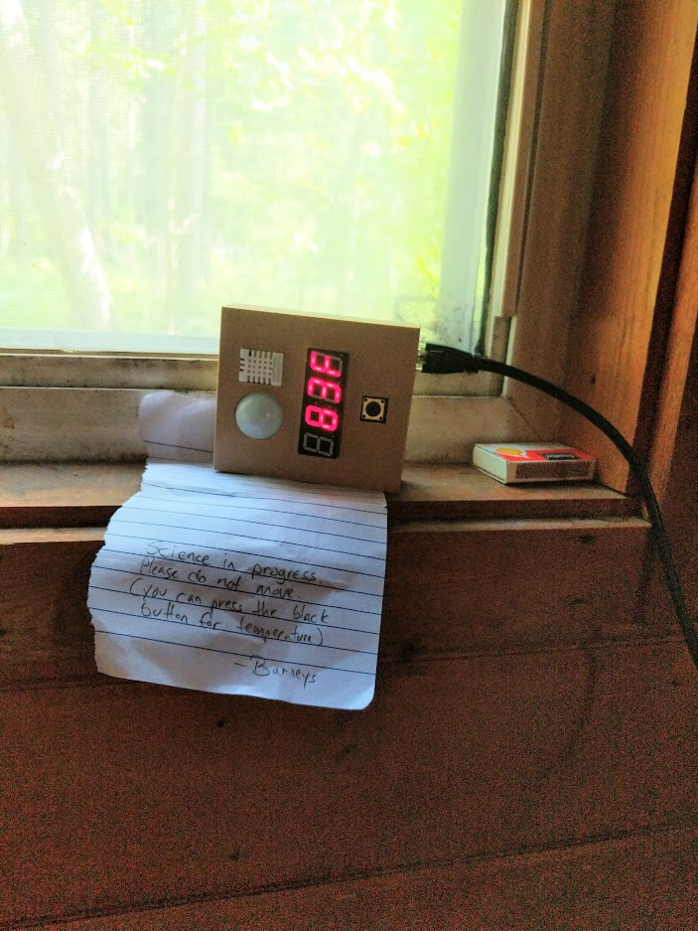
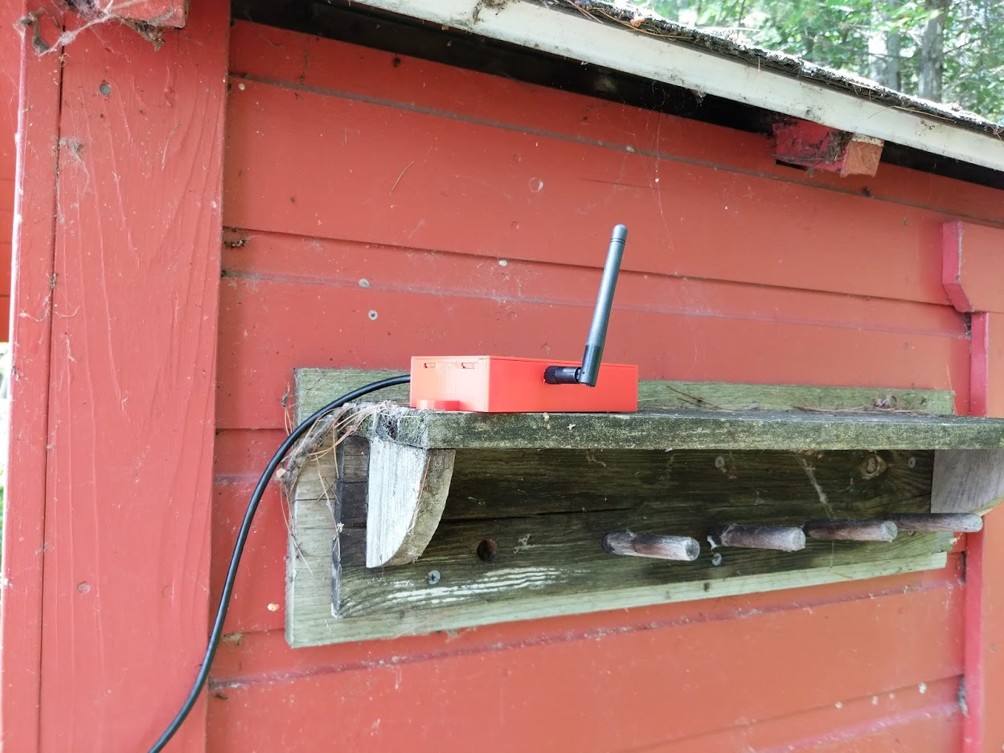
up to the lake!

Slide 67
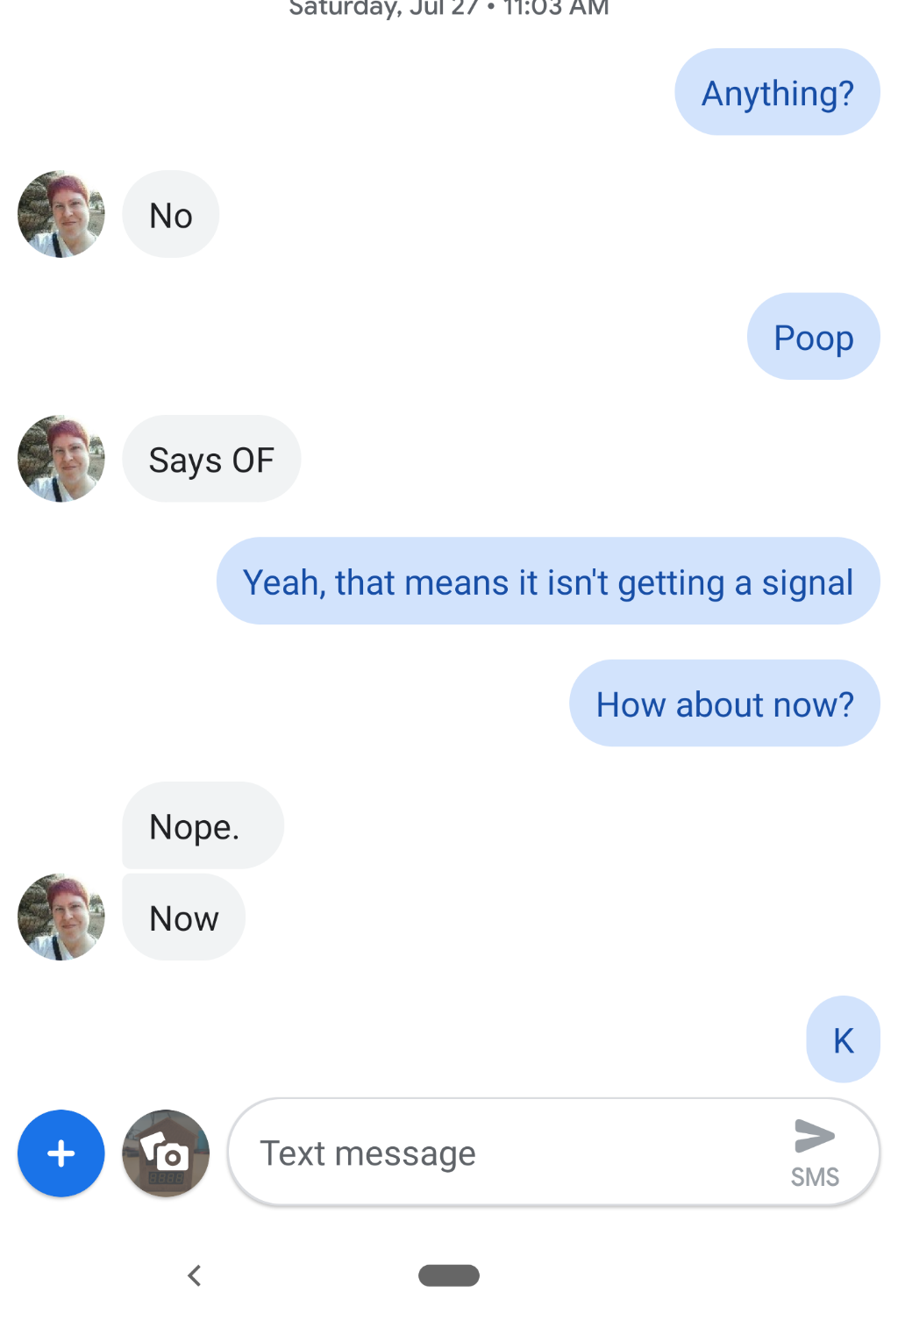
it didn't work

Slide 68
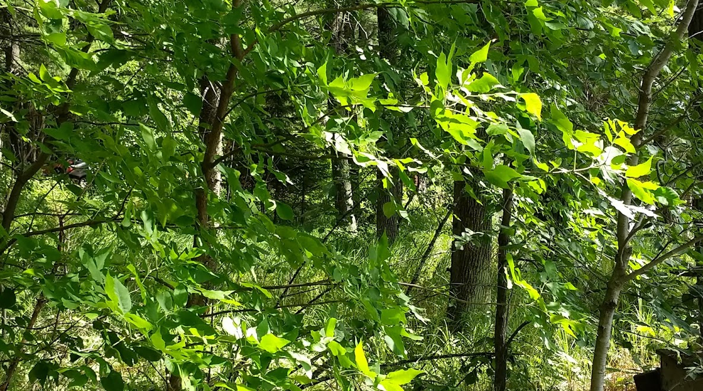
the problem:
Distance. And trees

Slide 69
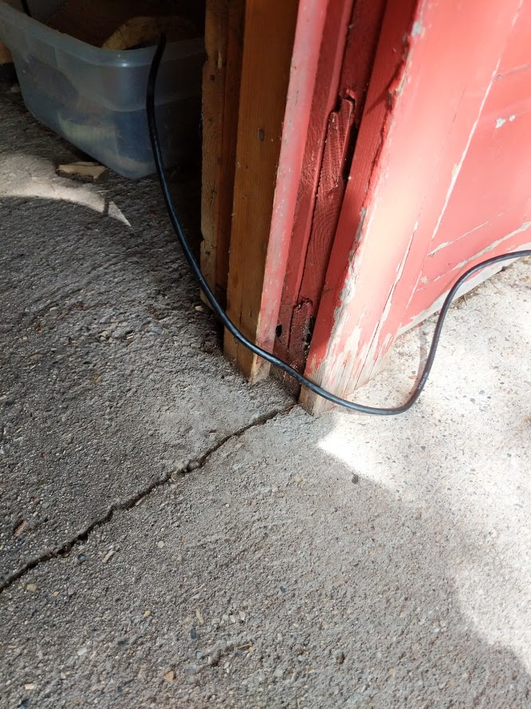
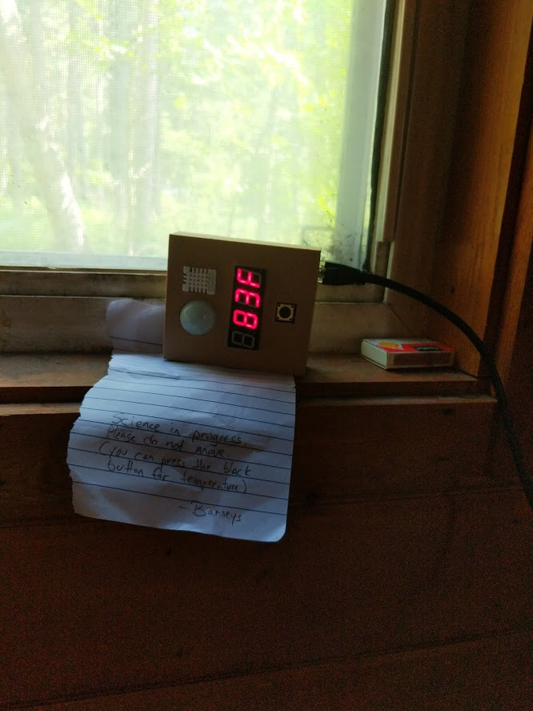
other problems
wiring from client unit to sensor unit
placement of sensor unit
still rather invasive and obvious
couldn't post to Azure table storage
enclosures all need another iteration or two

Slide 70

Notes:
Get the data to the cabin
Clear brush
More power
Relay
Make nice with neighbors
Mobile data
Reduce power further by using PIC microcontroller or ATTiny
Find better way to connect client with sensors
Reduce footprint of sensors

Slide 71

Notes:
Sauna monitor v2 – website, analytics, mobile app
Parking Partner v2
Video spotter for boat
RC boat or submarine
Sous vide cooker
Sprinkler controller
My own ring doorbell and/or nest thermostat

Slide 72

toolbox
the makers
1-2 development boards
Breadboards & power supplies
Jumper wires
Assortments or resistors, capacitors, LEDs, transistors, etc…
Wire cutters/strippers
Multimeter
Various sensors & actuators (as needed)
“Practical Electronics for Inventors”

Slide 73
Adam Barney
Quicken Loans
Senior Software Engineer
adambarney@quickenloans.com
adam@adambarney.com
Thank you!

